Slide 1
CPSC 315 BI Technologies
Excel Pivot Table Demo and Assignment

Slide 2
HW #1 Details
Due Monday, 1/27, by 5:00 pm
Submit files via GitHub Classroom
This presentation contains
Slides use during in-class demo
Specific instruction for the assignment

Slide 3
The story…
You are a real estate professional getting ready for a meeting with an important client. Your client is moving from across the country and wants to understand more about the homes for sale in a particular city. Your job is to produce an Excel Workbook that includes Pivot Tables and Charts that facilitate an investigation into the current state of the real estate market. Ultimately you will be telling a story that makes specific recommendations for your client.
Feel free to create a persona of your client
A young, price-conscious couple with three children, or
A single executive looking for an urban condo, or
An investor looking for bargain properties to fix-up and flip
Or, whatever you choose
Be sure to introduce your client in your presentation to provide context for your recommendations

Slide 4
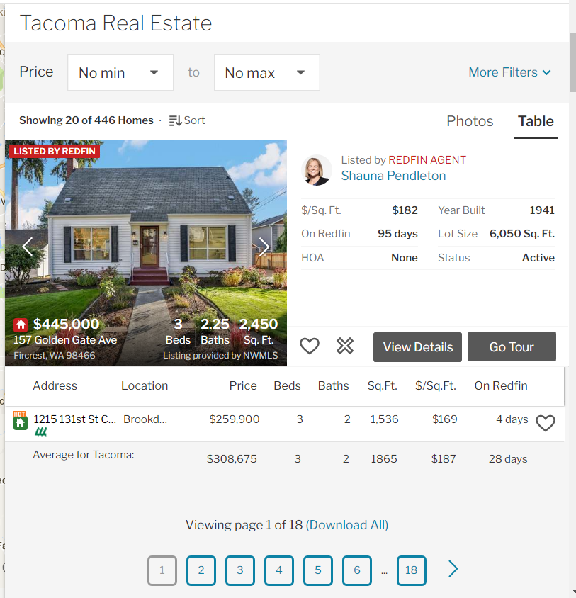
Getting the Data
https://www.redfin.com/
Search for a city with multiple zip codes
Make sure you are in Table view and scroll until you see the link to download
Open the downloaded .csv file and save as an Excel Workbook (.xlsx)
If you do not do this step you will not be able to save the results of your pivot table work

Slide 5
Data clean-up
Do not remove any columns as you may need them for an assignment later in the course
Some columns may be a mixture of good and bad data
Delete or fix data as you deem appropriate
You should only do this if you are getting errors building your pivot tables
Some rows may be outliers or not applicable to your story
Keep those rows since you may need them later
We will see how pivot tables let us include only data of interest without deleting rows
If your city has listings with 9 digit zip codes, insert a new column that uses the =LEFT() function to truncate zip codes to 5 digits
Create a new “Decade Built” column
Create a new “HOA Y/N” column

Slide 6
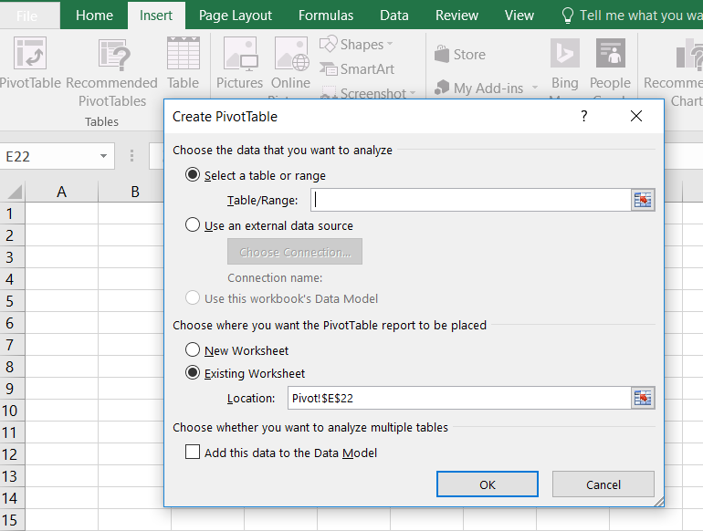
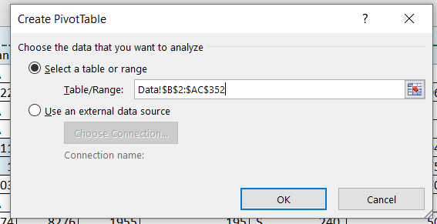
Creating a Pivot Table
Add a new sheet to your workbook
Insert a Pivot Table
Use your Data sheet as Table/Range

Slide 7
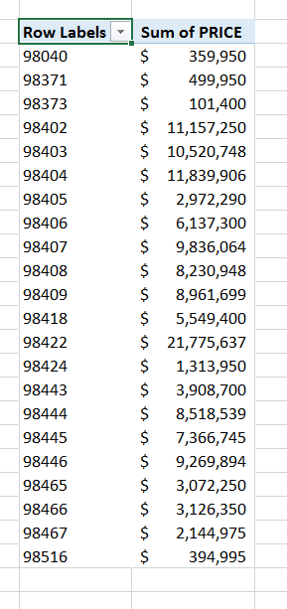
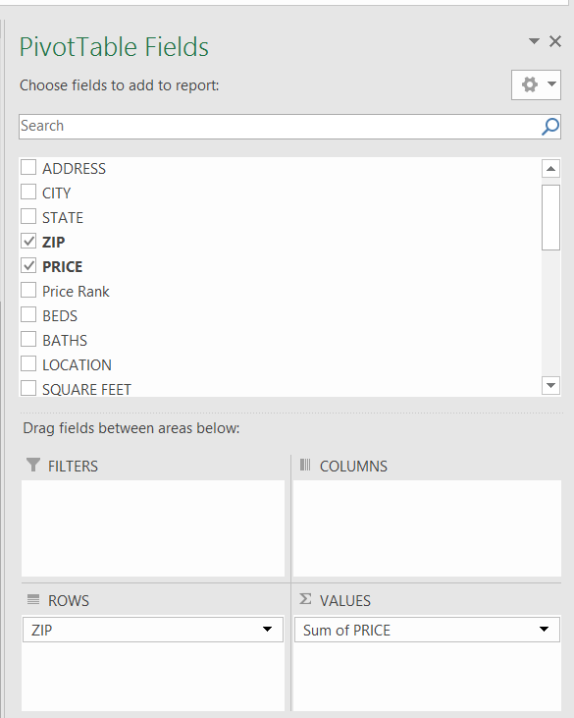
Analyze Price by Zip Code
Set up the pivot table
Use drop-down on Row Labels to sort/select
Dimensions
Measures

Slide 8
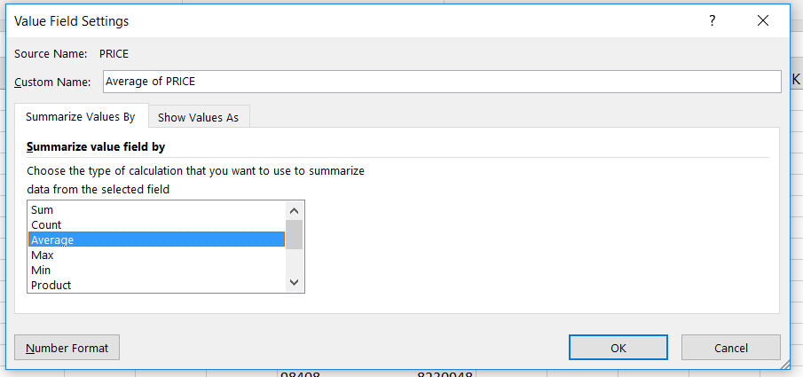
Aggregations
We are interested in functions other than sum

Slide 9
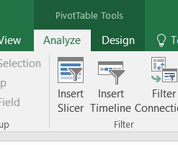
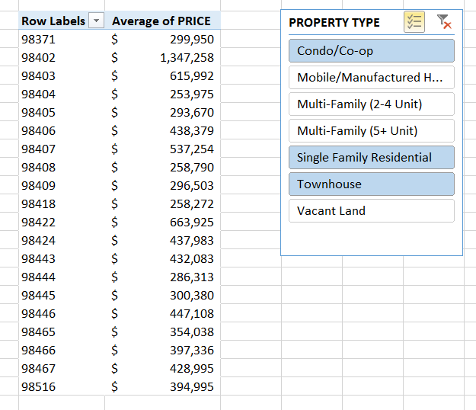
Slicers

Slide 10
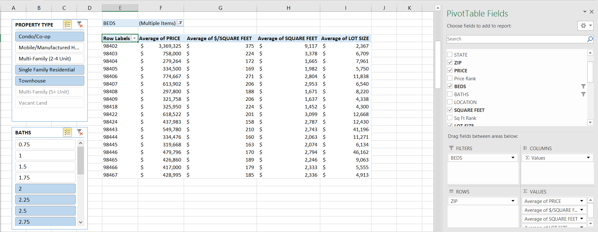
More Slicers and Values
Slicer vs. Filter
Similar functionality but slices shows selected values without dropdown

Slide 11
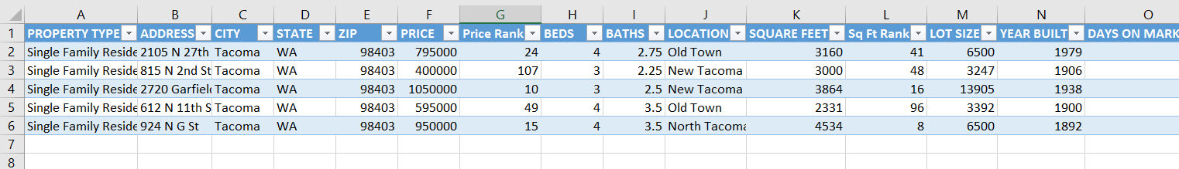
Drill-down
Double-click on a Price cell for one of the zip codes and watch what happens

Slide 12
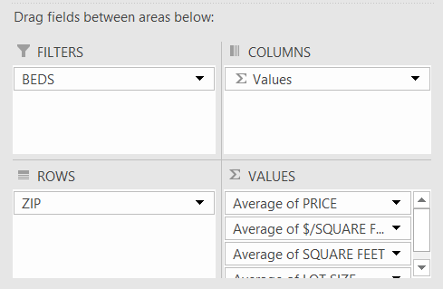
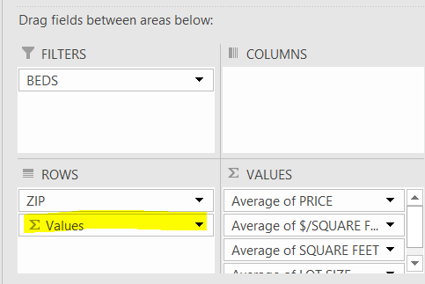
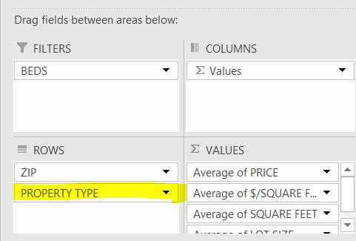
Some things to try…
Move values from Columns to Rows
Add Property Type under Rows

Slide 13
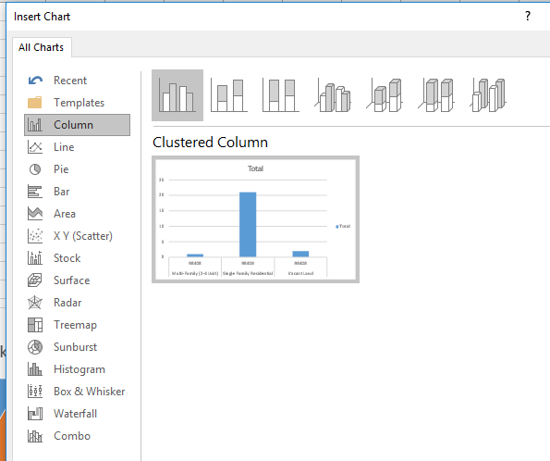
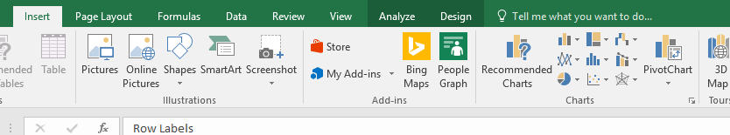
Inserting a Pivot Chart
Be sure your Pivot Table has the focus
You know the pivot table has focus if you see the list of Pivot Table Fields on the right side of the sheet
Click Insert on the ribbon and then Click on the Pivot Chart tile
Explore all of the different charts available

Slide 14
End of Demo
The remaining slides are the instructions for your assignment

Slide 15
Excel Pivot Table Assignment Instructions
Pick a city with multiple zip codes and download Redfin data
Choose any city you would like to explore
Be sure to save as an Excel Workbook (.xlsx)
Add a new sheet named Zip Code Analysis and insert a pivot table
Have rows be ZIP CODE and values be average of PRICE
Add slicers for BEDS and BATHS

Slide 16
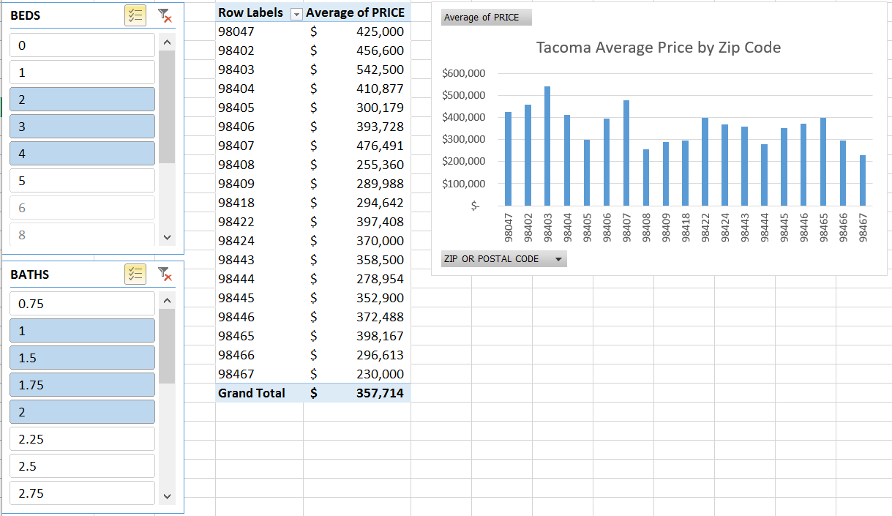
Excel Pivot Table Assignment Instructions
Add an appropriate pivot chart to your Zip Code Analysis sheet to help visualize price differences by zip code
Your finished sheet could look something like this

Slide 17
Excel Pivot Table Assignment Instructions
Add another new sheet named Property Type Analysis and insert a pivot table
Have rows be PROPERTY TYPE and values be count of PROPERTY TYPE
Add slicers and filters as appropriate
Add a pivot chart to show market share by PROPERTY TYPE
Pie charts are ideal for visualizing market share

Slide 18
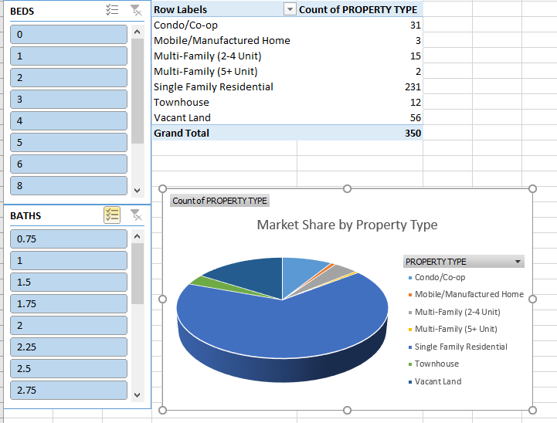
Excel Pivot Chart Assignment Instructions
Your finished Property Type Analysis sheet could look something like this

Slide 19
Excel Pivot Chart Assignment Instructions
Add at least two more sheets to the workbook with a different pivot table and pivot chart on each sheet
You have many possible dimension to include beyond ZIP CODE and PROPERTY TYPE
BEDS, BATHS, YEAR BUILT, DAYS ON MARKET…
You have many possible measures to include beyond PRICE and COUNT
SQUARE FEET, $/SQUARE FEET, LOT SIZE
Look for combinations of fields that will help you make a recommendation to your client and also allow you to try different pivot charts
Use Slicer and Filter capabilities to tailor the visualizations to support your recommendations
The next slide shows an example with BEDS as Rows, BATHS as Columns, and Average PRICE as Values

Slide 20
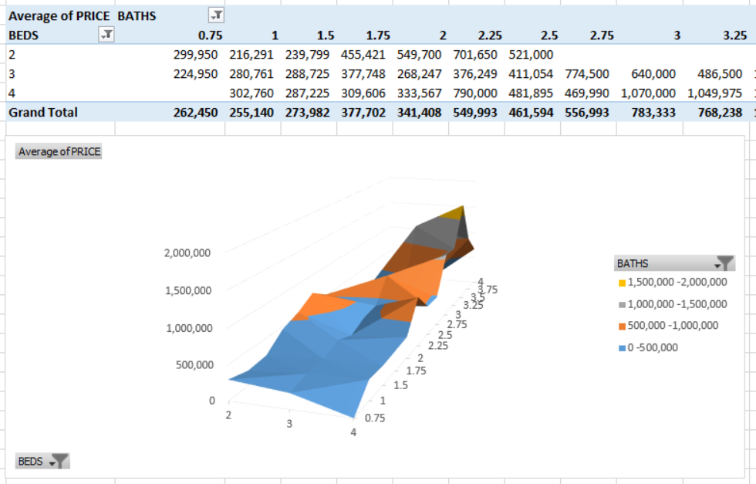
Excel Pivot Chart Example
A 3-D Surface pivot chart example with BEDS as Rows, BATHS as Columns, and Average PRICE as Values

Slide 21
Example Presentation Slide
The next slide shows how visualization can be used to tell a story
I added ZIP CODE as a row to my Property Type Analysis pivot table
I then filtered for 98402
Copy the chart
Paste onto a slide
I then filtered for 98408
Copy the chart
Paste onto a slide
Add title and text to tell the story

Slide 22
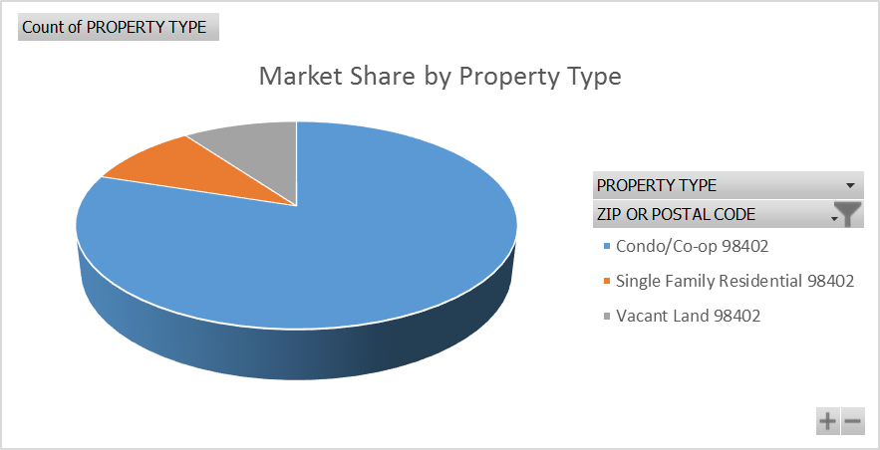
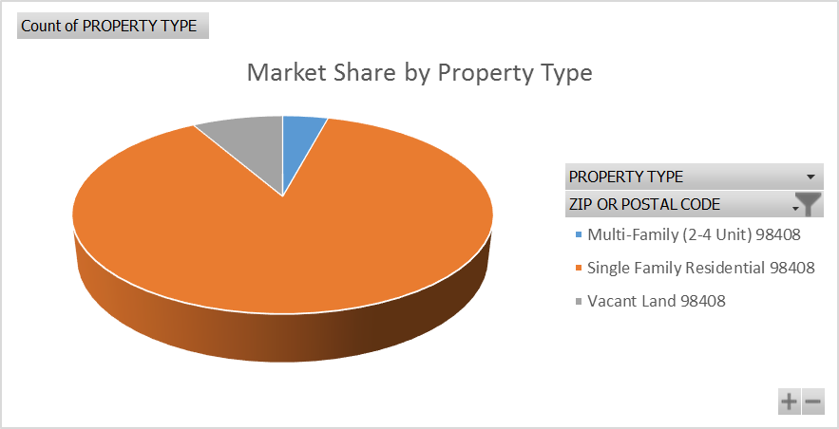
Where should we target our search?
You were interested in a condo in either 98402 or 98408
Here is some information about properties in each zip code
My recommendation is that we focus our search in 98402

Slide 23
For your assignment submission
Produce a 10 slide PowerPoint deck
Use the first few slides to show that you completed everything requested
Using the Pivot Tables and Charts you built, dive into the data and look for buying opportunities for your client
Perhaps identify zip codes that provide better value, or
Property types that have been on the market for a while that could be ready for a price reduction, or
Include YEAR BUILT in your analysis
Maybe there are opportunities for newer homes, or older homes, or ???
Something else you discover in the data
Use the remaining slides to make recommendation to your client based on the above analysis
Be sure to include snips of the pivot charts that support your recommendation

Slide 24
What to submit
A 10 slide PowerPoint deck as described on the previous slide
Your Excel Workbook (.xlsx format)
Notes:
You have creative license, use it
You do not need my permission to go above and beyond what was requested
Be sure you tell a story
Support your decisions and recommendations with Analytics
Do not expect Analytics to stand on their own
Numerous how-to videos are available online
Do a search for “pivot table video” if you get stuck
Pivot tables and charts are an excellent resume and interview item
Use this assignment to build a skill for a lifetime

Slide 25
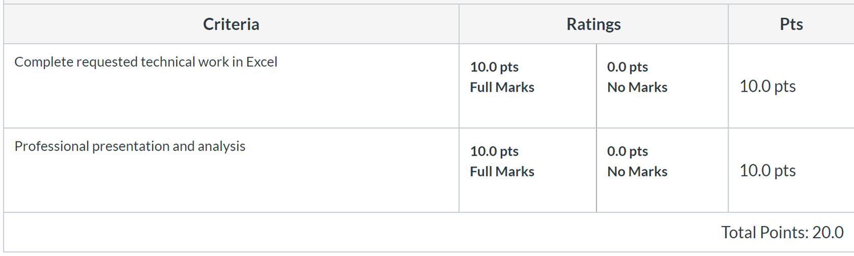
Grading Rubric
Let’s look at 2 examples that received full credit…

